Slide 1

Finite Automaton with output
BSCS
BSSE

Slide 2
Finite Automaton with output
Finite automaton discussed so far, is just associated with the RE or the language.
There is a question whether does there exist an FA which generates an output string corresponding to each input string ? The answer is yes. Such machines are called machines with output.
There are two types of machines with output. Moore machine and Mealy machine

Slide 3
The are two types of machine (FAs) with output capabilities. These are create by G.H Mealy (1955) and, independently by E.F Moore (1956). The original purpose of the inventors was to design a mathematical model for sequential circuits, which are only one component of the architecture of a whole computer.

Slide 4
Moore machine
A Moore machine consists of the following
A finite set of states q₀, q₁, q₂, … where q₀ is the initial state.
An alphabet of letters Σ = {a,b,c,…} from which the input strings are formed.
An alphabet Г={x,y,z,…} of output characters from which output strings are generated.
4. A transition table that shows for each state and each input letter what state is entered the next.
5. An output table that shows what character is printed by each state as it is entered.

Slide 5
Note:
The Moore machine prints the output character of start state even before looking at the input letter.
Since there is no state designated to be a final state, so there is no question of accepting any language by Moore Machine.
The state to be initial is not important as if the machine is used several times and is restarted after some time, the machine will be restarted from the state where it was left off.

Slide 6
Note: It is to be noted that since in Moore machine no state is designated to be a final state, so there is no question of accepting any language by Moore machine. However in some cases the relation between an input string and the corresponding output string may be identified by the Moore machine. Moreover, the state to be initial is not important as if the machine is used several times and is restarted after some time, the machine will be started from the state where it was left off. Following are the examples:

Slide 7
Example
Consider the following Moore machine having the states q₀, q₁, q₂, … where q₀ is the start state and
Σ = {a,b},
Г={0,1}
the transition table follows as

Slide 8
Example continued …
Old states | New states after reading
 | a | b
q0- | q1 | q3
q1 | q3 | q1
q2 | q0 | q3
q3 | q3 | q2
Characters to be printed
1
0
0
1

Slide 9
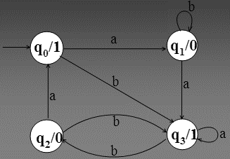
Example continued …
It is to be noted that the states are labeled along with the characters to be printed. Running the string abbabbba over the above machine, the corresponding output string will be 100010101, which can be determined by the following table as well.

Slide 10
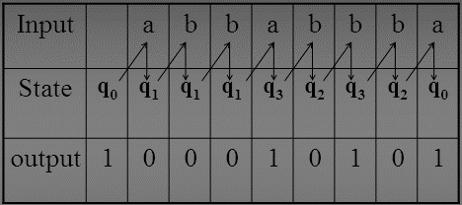
Example continued …
It may be noted that the length of output string is l more than that of input string as the initial state prints out the extra character 1, before the input string is read.

Slide 11
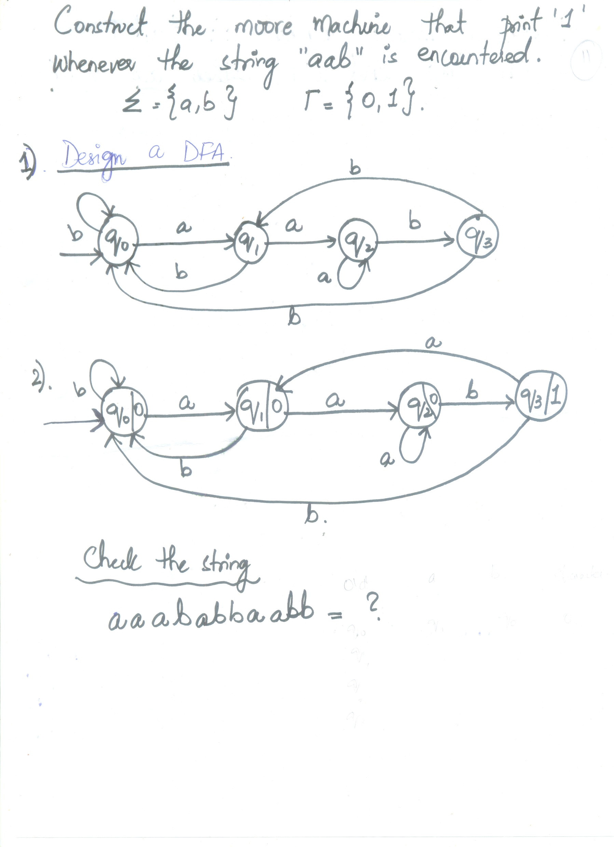

Slide 12
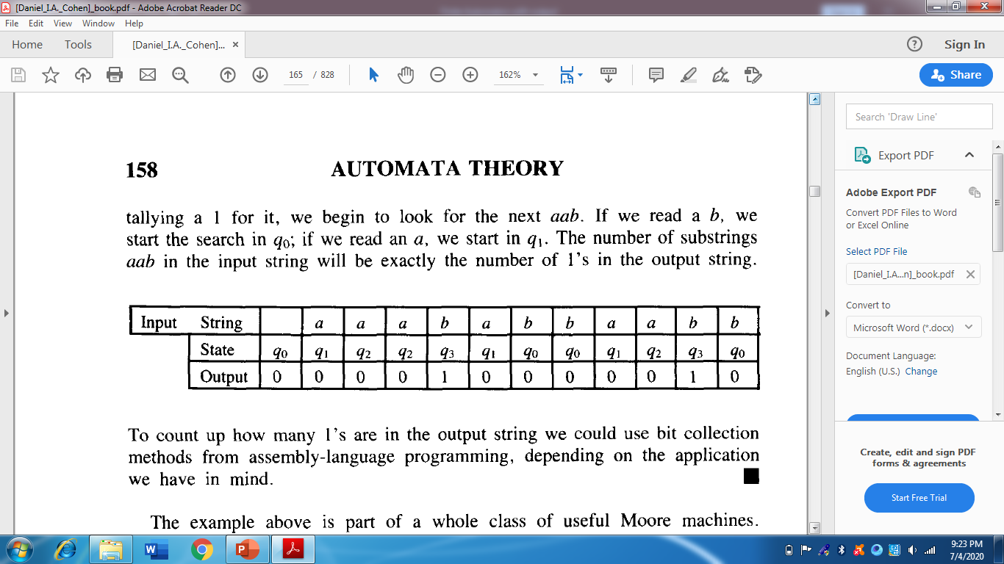
Count how many times the substring aab occurs in a long input string

Slide 13
Mealy machine
A Mealy machine consists of the following
A finite set of states q₀, q₁, q₂, … where q₀ is the initial state.
An alphabet of letters Σ = {a,b,c,…} from which the input strings are formed.
An alphabet Г={x,y,z,…} of output characters from which output strings are generated
A pictorial representation with states and directed edges labeled by an input letter along with an output character. The directed edges also show how to go from one state to another corresponding to every possible input letter

Slide 14
Note
It is to be noted that since, similar to Moore machine, in Mealy machine no state is designated to be a final state, so there is no question of accepting any language by Mealy machine. However in some cases the relation between an input string and the corresponding output string may be identified by the Mealy machine.
Moreover, the state to be initial is not important as if the machine is used several times and is restarted after some time, the machine will be started from the state where it was left off. Following are the examples

Slide 15
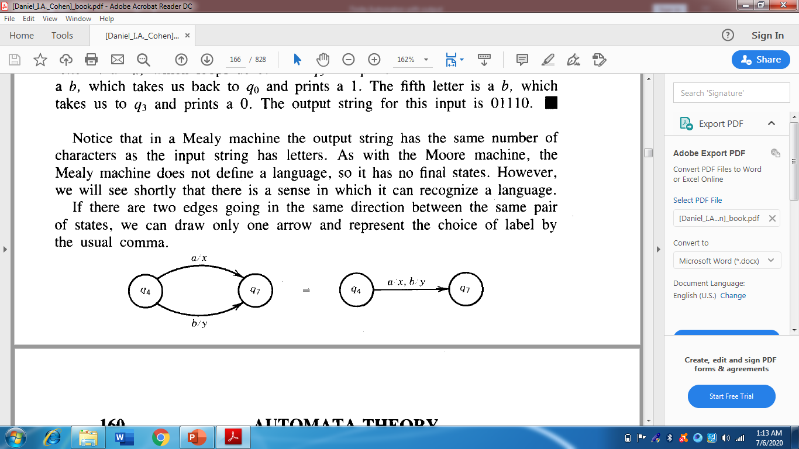

Slide 16
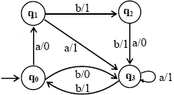
Example
Consider the Mealy machine shown aside, having the states q0, q1, q2, q3 , where q0 is the start state and
Σ = {a,b},
Г ={0,1}

Slide 17
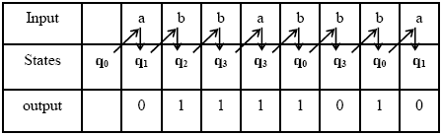
Example Cont…..
Running the string abbabbba over the above machine, the corresponding output string will be 01111010, which can be determined by the following table as well
It may be noted that in Mealy machine, the length of output string is equal to that of input string.

Slide 18
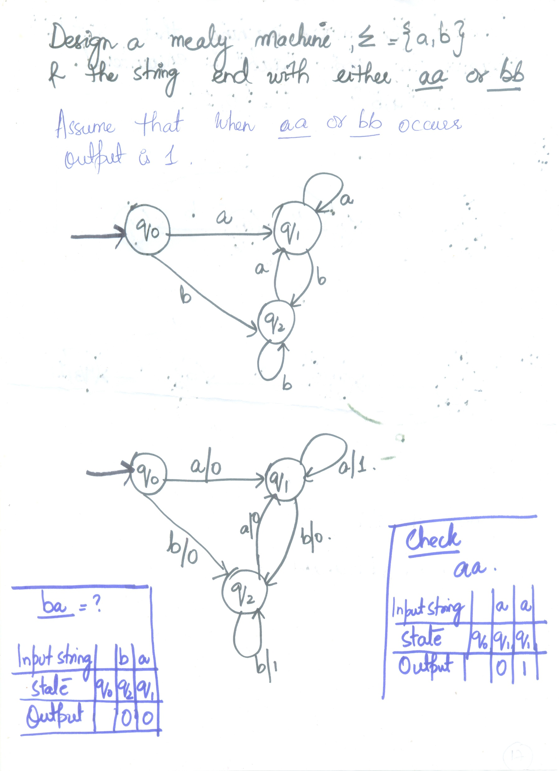

Slide 19

Example
Consider the Mealy machine shown aside, having the only states q0, where q0 is the start state and
Σ = {0, 1},
Г = {0,1}
If 0011010 is run on this machine then the corresponding output string will be 1100101.
This machine is called Complementing machine.

Slide 20
Constructing the incrementing machine
In the previous example of complementing machine, it has been observed that the input string and the corresponding output string are 1’s complement of each other.
There is a question whether the Mealy machine can be constructed, so that the output string is increased, in magnitude, by 1 than the corresponding input string?
The answer is yes.

Slide 21
This machine is called the incrementing machine. Following is how to construct the incrementing machine. Before the incrementing machine is constructed, consider how 1 is added to a binary number.
Since, if two numbers are added, the addition is performed from right to left, so while increasing the binary number by 1, the string (binary number) must be read by the corresponding Mealy machine from right to left, and hence the output string (binary number) will also be generated from right to left.
Consider the following additions

Slide 22
a) 100101110
+ 1
______________
100101111
b) 1001100111
+ 1
______________
1001101000
It may be observed from the above that
a) If the right most bit of binary number, to be incremented, is 0, the output binary number can be obtained by converting the right most bit to 1 and remaining bits unchanged.
b) If the right most bit of binary number is 1 then the output can be obtained, converting that 1 along with all its concatenated 1’s to 0’s, then converting the next 0 to 1 and remaining bits unchanged.

Slide 23
Observation
The observations (a) and (b) help to construct the following Incrementing (Mealy) machine.
The Mealy machine, having the states q0, q1, q2 where q0 is the start state and
Σ = {0, 1},
Г = {0,1}

Slide 24
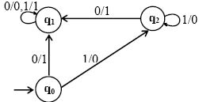
Incrementing (Mealy) machine

Slide 25
Observation
It may be observed that, in the incrementing machine, if 0 is read at initial state q0, that 0 is converted to 1 and a no change state q1 (no carry state) is entered where all 0’s and all 1’s remain unchanged.
If 1 is read at initial state, that 1 is converted to 0 and the state q2 (owe carry state) is entered, where all 1’s are converted to 0’s and at that state if 0 is read that 0 is converted to 1 and the machine goes to no change state.
If the strings 100101110 and 1001100111 are run over this machine, the corresponding output strings will be 100101111 and 1001101000 respectively.

Slide 26
Note
It is to be noted that if the string 111111 is run over the incrementing machine, the machine will print out 000000, which is not increased in magnitude by 1. Such a situation is called an overflow situation, as the length of output string will be same as that of input string.
It may also be noted that there exists another incrementing machine with two states.

Slide 27
Applications of Incrementing and Complementing machines
1’s complementing and incrementing machines which are basically Mealy machines are very much helpful in computing.
The incrementing machine helps in building a machine that can perform the addition of binary numbers.
Using the complementing machine along with incrementing machine, one can build a machine that can perform the subtraction of binary numbers.

Slide 28
Subtracting a binary number from another
Method: To subtract a binary b from a binary number a
Add 1’s complement of b to a (ignoring the overflow, If any)
Increase the result, in magnitude, by 1 (use the incrementing machine). Ignoring the overflow if any.
Note: if there is no overflow in (1). Take 1’s complement once again in (2), instead. This situation occurs when b is greater than a, in magnitude. Following is an example of subtraction of binary numbers.

Slide 29
Example
To subtract the binary number 101 from the binary number 1110, let
a = 1110 and b = 101 = 0101.
(Here the number of digits of b are equated with that of a)
Adding 1’s complement (1010) of b to a.
1110
+1010
11000 which gives 1000 (ignoring the overflow)

Slide 30
Example Continued
Using the incrementing machine, increase the above result 1000, in magnitude, by 1
1000
+1
________
1001 which is the same as obtained by ordinary subtraction.

Slide 31
Note
It may be noted that the above method of subtraction of binary numbers may be applied to subtraction of decimal numbers with the change that 9’s complement of b will be added to a, instead in step (1). Following is the task in this regard

